Slide 1
Williams international data transformation project
Simon lidwell

Slide 2
Agenda
Organization/Industry Description
Problem Description
Problem Solution
Evaluation of Potential Solutions
Business Benefits
Conclusion

Slide 3
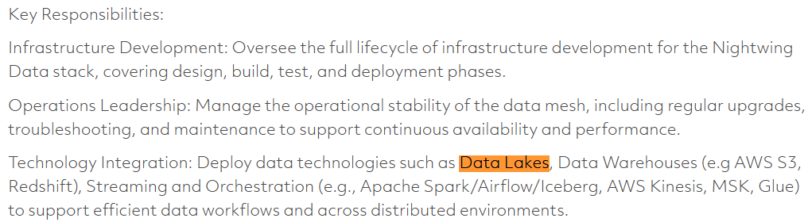
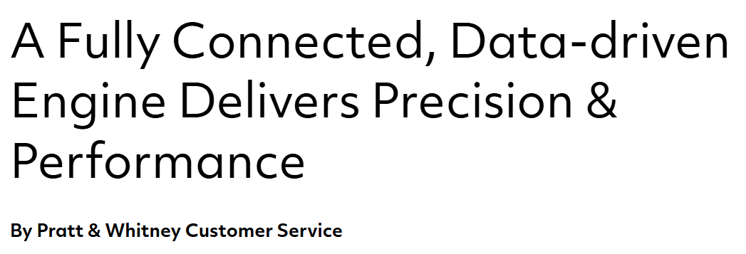
Williams international
Competitors:
Raytheon
Pratt & Whitney
Notes:
https://careers.rtx.com/global/en/job/01736702/Data-Infrastructure-Lead#:~:text=Infrastructure%20Development:%20Oversee%20the%20full,retrieval%20speed%2C%20and%20system%20resilience.
https://www.prattwhitney.com/en/blogs/airtime/2017/05/29/a-fully-connected-data-driven-engine-delivers-precision-and-performance#:~:text=Empowerment%20Through%20Data:%20the%20Future%20is%20Now&text=While%20you%20are%20piloting%20a,by%20dispatching%20a%20needed%20part.&text=You%20are%20an%20operator%20on,the%20Connected%20Engine%20video%20below.

Slide 4
Problem description
Williams International is pursuing a digital transformation of their business, yet several data-related challenges hinder their ability to leverage modern insights
Current Problems
Siloed data across systems
Complex data types for modern manufacturing
Legacy data trapped in unstructured formats

Slide 5
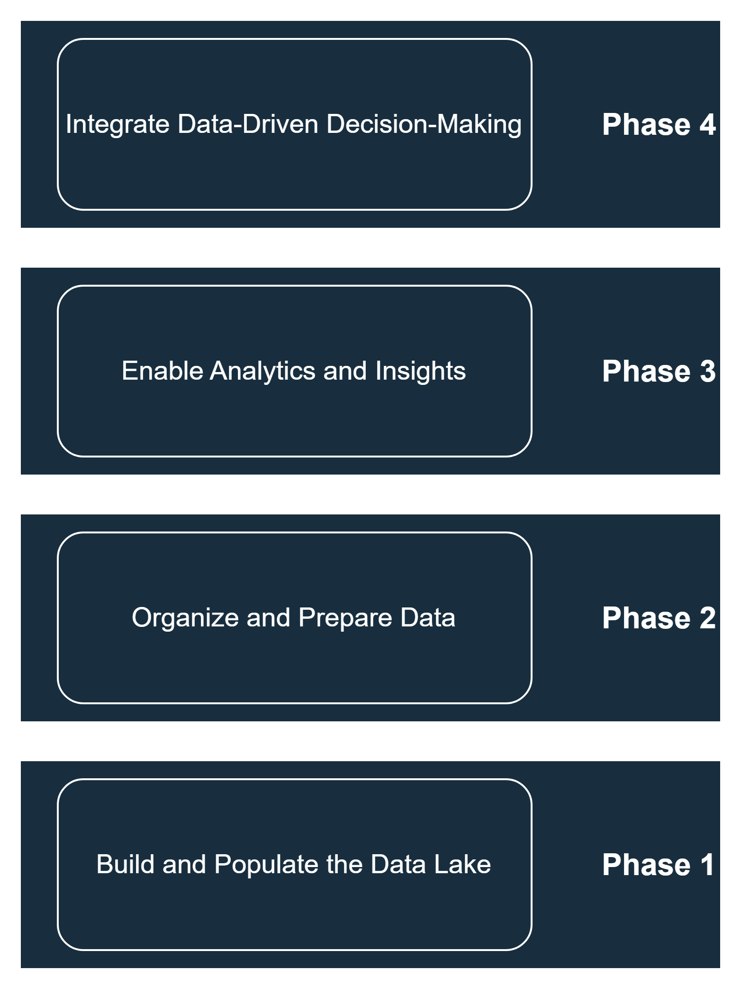
Solution
WI Data Engineering builds out a custom data lake solution in four main phases

Slide 6
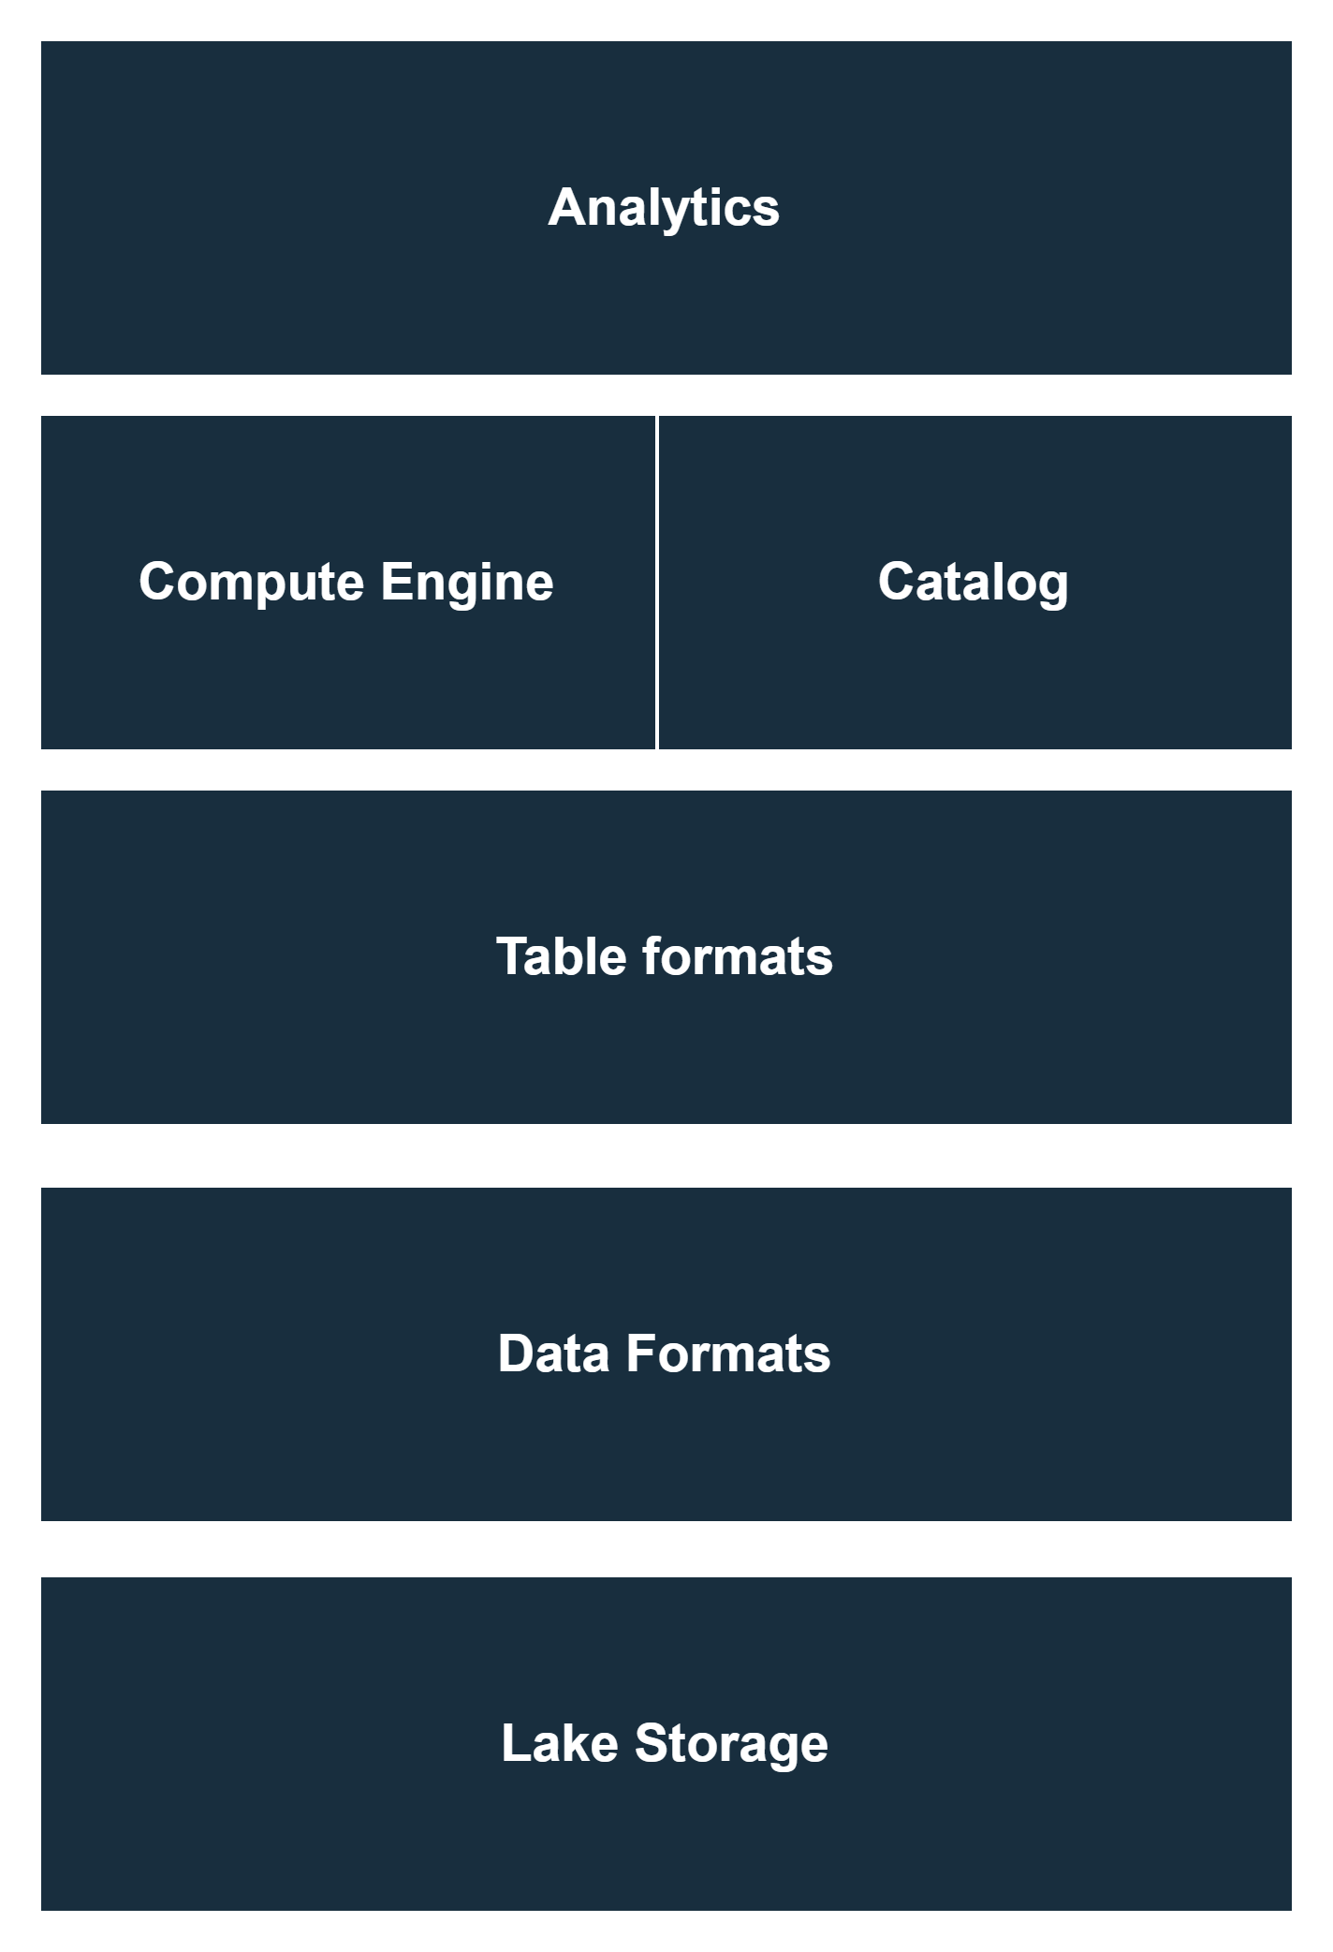
Data lakes
A data lake is a centralized storage system that holds raw data from various sources in its native format; structured, semi-structured, and unstructured.
Notes:
Structured (like rdbms)
Semi-structured (like json)
Unstructured (like images or videos)
A data lake is not “one tool” but many put together, more like a concept of a tool

Slide 7
Evaluation of potential solutions
Build our own data lake
Buy an on-premise data lake
Explore cloud options

Slide 8
Business benefits

Slide 9
THANK YOU
Simon Lidwell​
slidwell@oakland.edu

Slide 10
References
https://hudi.apache.org/blog/2024/07/11/what-is-a-data-lakehouse

